Slide 2
Setting up your developer environment for SPFx
Nanddeep Nachan

Slide 3






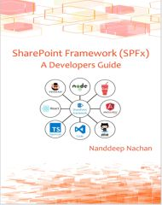
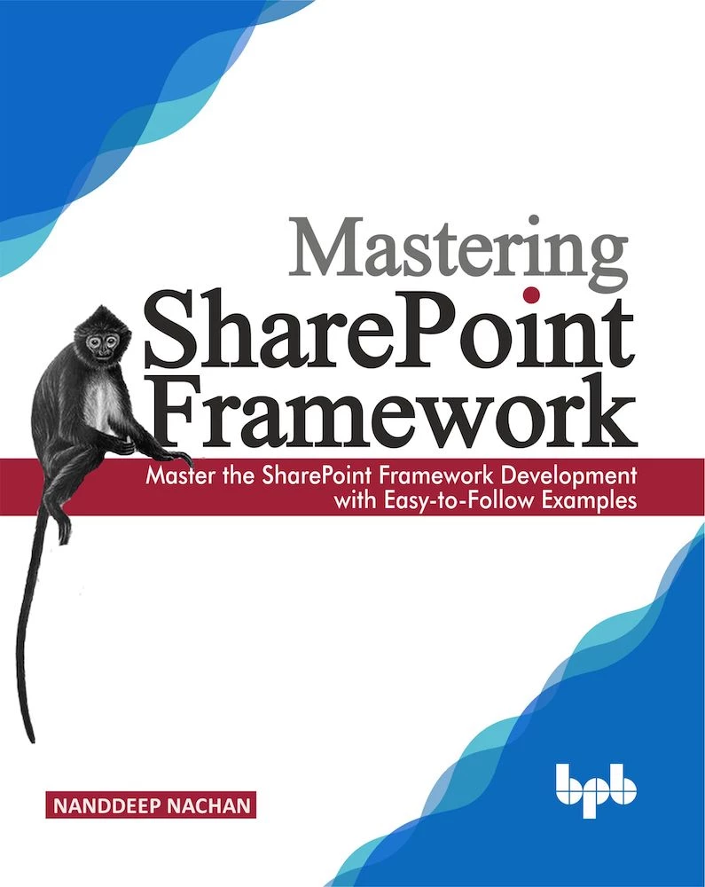



Nanddeep Nachan
Consultant - SharePoint, Office 365, MS Azure
Speaker | Author | Blogger
Microsoft Certified Professional
Certified Scrum Master (CSM)
Certified Professional Photographer
NanddeepNachan@gmail.com
@NanddeepNachan
/in/nanddeepnachan
nanddeepnachan
nanddeepn

Slide 4


The book is intended for anyone looking for a career in modern SharePoint, all aspiring SharePoint developers who want to learn the most powerful technique to extend the SharePoint user interface or working professionals who want to switch their career in SharePoint. While no prior knowledge of SharePoint, open-source tooling and modern toolchain or related technologies is assumed, it will be helpful to have some programming experience.
You can order the book at https://www.amazon.in/Mastering-Sharepoint-Framework-Easy-Follow/dp/938932887X/

Slide 5
SPFX Toolchain
Light weight Components / Tools Used
Set up developer environment
Flow of SPFx Client Side Web Part
Build first SPFx Web Part

Slide 6
Pre-requisites

Slide 7
A Development Environment
Office 365 / SharePoint Online Tenant
App catalog for deployment
Development workstation:
Window / Mac / Linux
Toolchain is open source – do not need a dedicated dev environment
Much more simple than classic SharePoint Development

Slide 8
Set up your Office 365 tenant
Get an Office 365 developer subscription
Join the Office 365 Developer Program
https://developer.microsoft.com/office/dev-program

Slide 9
Light weight Components / Tools Used

Slide 10
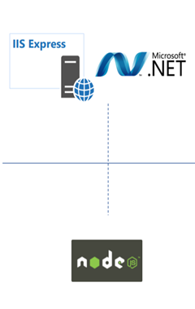

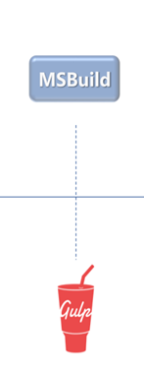
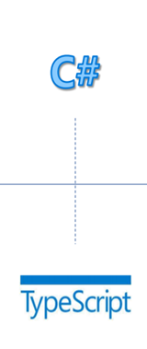
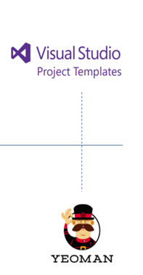
Light weight Components / Tools Used

Slide 11
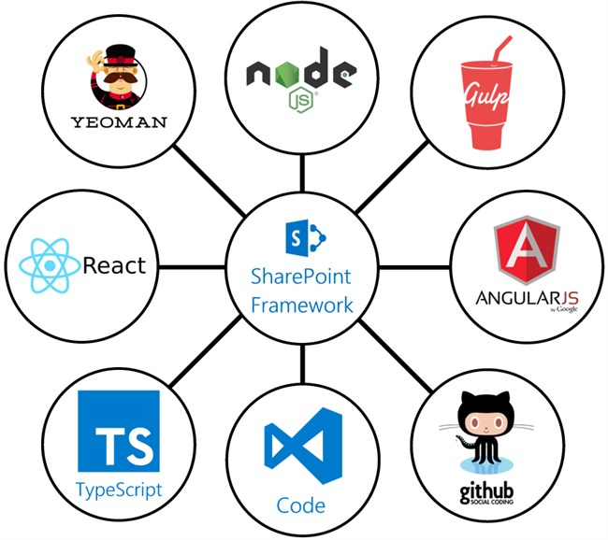
Skills You Need to Embrace
JavaScript / HTML / CSS
TypeScript
Node.js
NPM
Yeoman
Gulp
Office UI Fabric

Slide 12

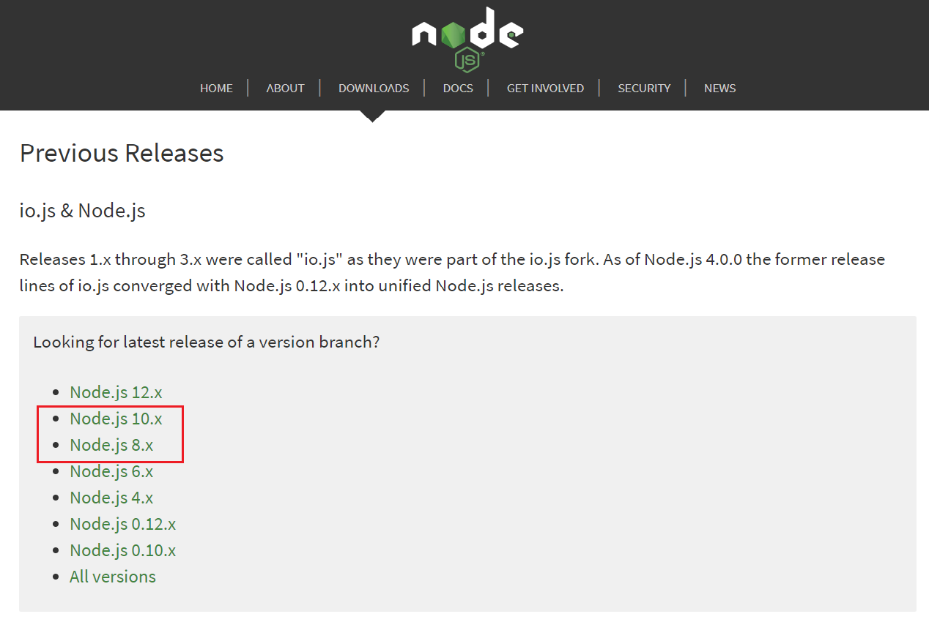
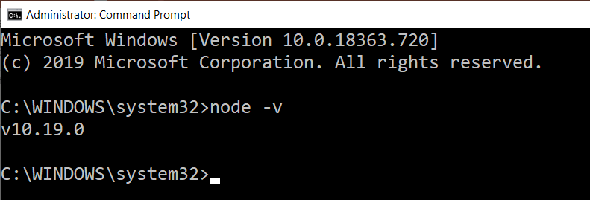
Node.js
https://nodejs.org
Overview
Open source JavaScript runtime
Used to build and run the applications, which is equivalent to the .Net
SPFx supports Node.js v8.x and Node.js v10.x
Verification of a successful install

Slide 13
Troubleshooting
Node.js

Slide 14
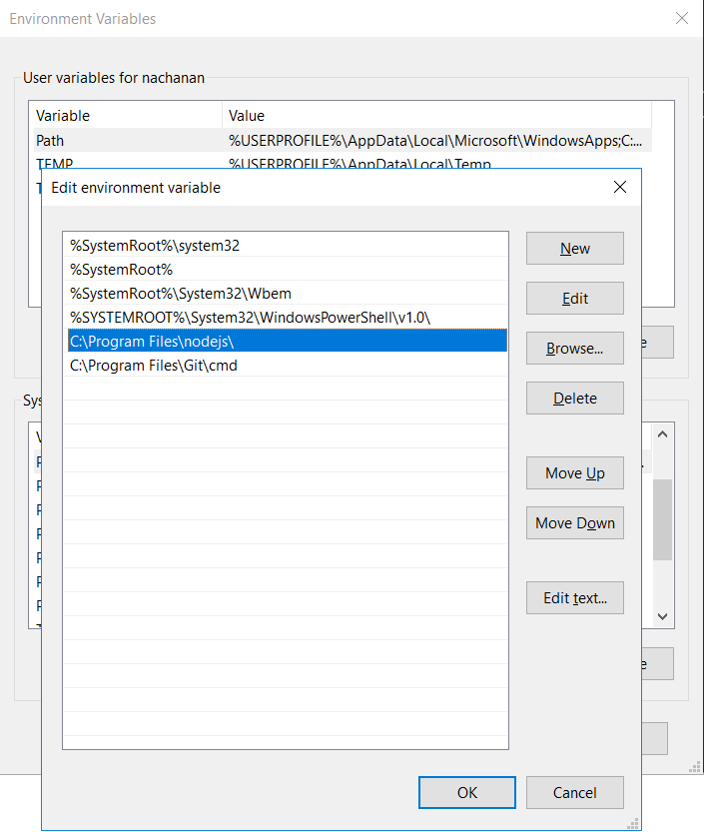
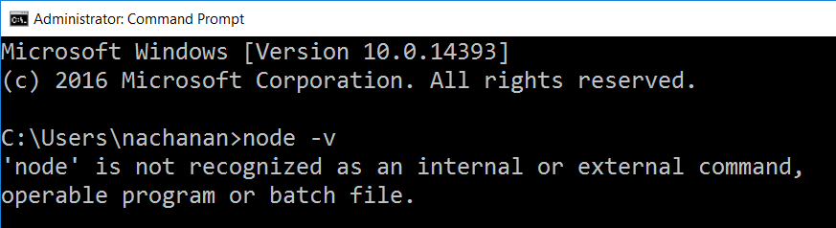
'node' is not recognized as an internal or external command

Slide 15
Install Packages with NPM behind Corporate Proxies
If your development environment is behind a corporate proxy
Configure NPM to use that proxy
Refer npm-config (https://docs.npmjs.com/misc/config)
npm config set proxy http://proxy.company.com:8080 npm config set https-proxy http://proxy.company.com:8080

Slide 16

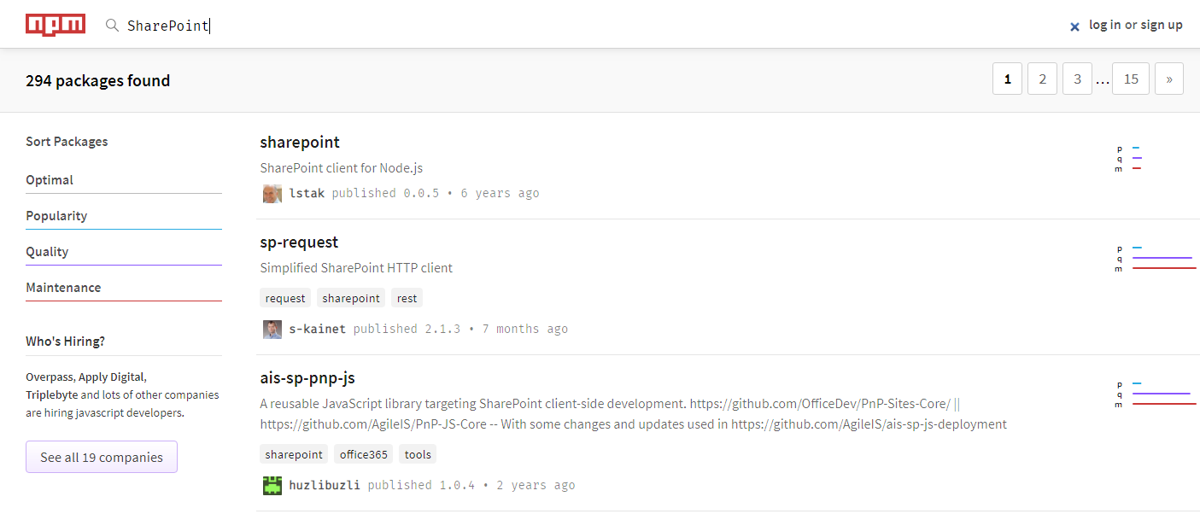
NPM (Node Package Manager)
Overview
Package manager for JavaScript
Installs modules and its dependencies (equivalent to Nuget Package)
Packages can be installed globally (-g switch) or locally
Installed packages goes inside node_modules folder
https://www.npmjs.com/

Slide 17

Gulp (Task and Build Manager)
http://gulpjs.com
Overview
Equivalent to MSBuild in Microsoft World
Automates SPFx development and deployment tasks
Bundle and minify JavaScript and CSS files
Run tools to call the bundling and minification tasks before each build
Compiles LESS or SASS files to CSS
Compiles TypeScript files to JavaScript
Compiles, bundle and copies files to deployment folder for packaging
npm install -g gulp

Slide 18

TypeScript (Typed JavaScript)
Overview
Superset of JavaScript
Strongly typed language
Adds compile time syntax and type checking for JavaScript
Help to build the Applications which will be then compiled to clean JS code
Install TypeScript
npm install -g typescript
Update TypeScript to latest version
npm install -g typescript@latest

Slide 19

Yeoman (SharePoint Solution Generator)
Overview
Relies on NPM and Gulp
Scaffolding tool for Modern web apps
Used as SPFx solution generator and builds required project structure
‘yo’ is the command line utility for creation of projects
Install Yeoman
npm install -g yo
Install Yeoman SharePoint Generator
npm install -g @microsoft/generator-sharepoint

Slide 20




Visual Studio Code
Overview
Interface for working with SPFx solutions
Fast and light weight IDE
Can work on Windows, Mac OS, and Linux
https://code.visualstudio.com
Other IDEs
Atom (https://atom.io)
Webstorm (https://www.jetbrains.com/webstorm)
Sublime (https://www.sublimetext.com)
Visual Studio SPFx Project Template (VS2015, VS2017) (https://marketplace.visualstudio.com/items?itemName=SharePointPnP.SPFxProjectTemplate)

Slide 21




Optional Tools
Fiddler (HTTP debugging by recording Web traffic)
Postman plugin for Chrome
Cmder for windows (Console Emulator)
Git source control tools

Slide 22
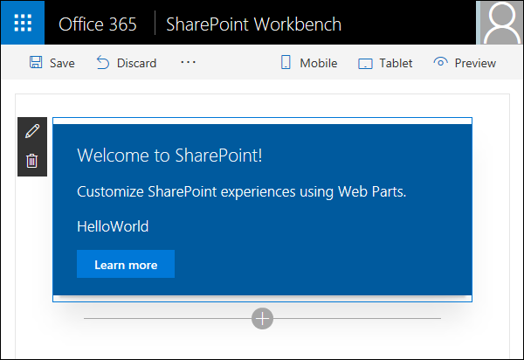
Workbench
Overview
Test without SharePoint
An HTML page
Allows to add client side web parts
Launches local web server
Can run locally or within SharePoint Online
Local workbench:
https://localhost:4321/temp/workbench.html
SharePoint workbench: https://<tenant>.sharepoint.com/sites/<site>/_layouts/15/workbench.aspx
Trust-dev-cert to install a local SSL certificate

Slide 23
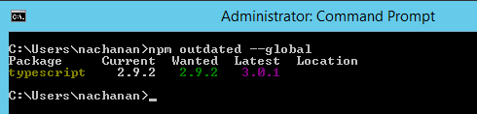
Updating NPM packages
Update NPM
npm install -g npm
Check outdated packages
npm outdated --global
Update reported packages
npm update -g <package-name>

Slide 24
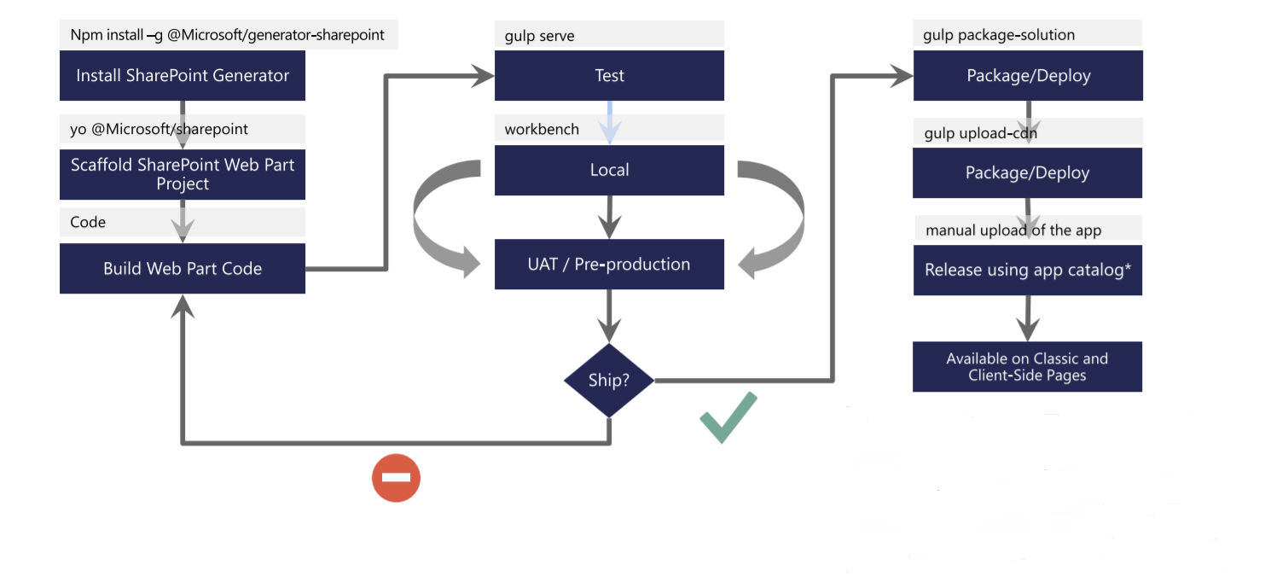
Flow of SPFx Client Side Web Part

Slide 25
Build Your First SPFx WebPart
C:\> md helloword-webpart
C:\> cd helloword-webpart
C:\> yo @Microsoft/sharepoint
Grab a cup of coffee. First time in a project, this will take a while
You can execute yo command again to add more webparts to project
Each addition of a webpart to a project will take much less time to scaffold
C:\> gulp serve

Slide 26
Develop First SPFx client-side web part

Slide 27
Create app catalog site
You need an app catalog to upload and deploy web parts.
Tenant App Catalog
Site Collection App Catalog
PowerShell
Add-SPOSiteCollectionAppCatalog -Site https://contoso.sharepoint.com/sites/marketing

Slide 28

Support multiple versions of SPFx?
SPFx 1.0.0
SPFx 1.4.1
SPFx 1.7.0
SPFx 1.9.1
SPFx 1.10.0
Run SharePoint Framework in a Docker container.
Use docker to host multiple different versions of SPFx.
Use the right version of the SharePoint Framework for the particular project.
Learn more:
https://blog.mastykarz.nl/sharepoint-framework-docker/
https://blog.mastykarz.nl/sharepoint-framework-docker-image-your-team/

Slide 29
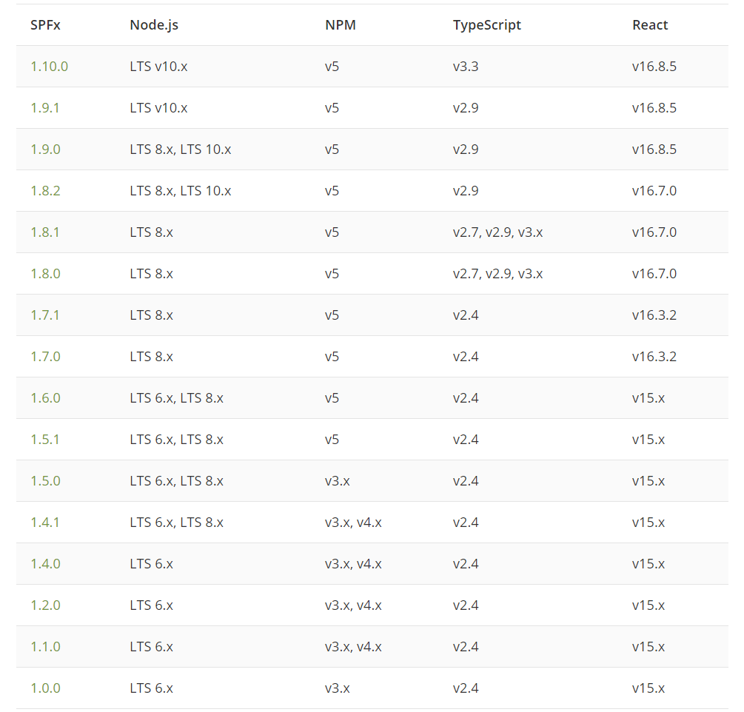
SPFx Development Environment Compatibility
Source: https://tahoeninjas.blog/2019/12/30/spfx-compatibility-matrix/

Slide 30
References
Set up your Office 365 tenant
https://docs.microsoft.com/en-us/sharepoint/dev/spfx/set-up-your-developer-tenant
Set up your SharePoint Framework development environment
https://docs.microsoft.com/en-us/sharepoint/dev/spfx/set-up-your-development-environment
Use the site collection app catalog
https://docs.microsoft.com/en-us/sharepoint/dev/general-development/site-collection-app-catalog
Build your first SPFx web part
https://dev.office.com/sharepoint/docs/spfx/web-parts/get-started/build-a-hello-world-web-part

Slide 31
Q&A

Slide 32
NanddeepNachan@gmail.com
@NanddeepNachan
/in/nanddeepnachan
nanddeepnachan
nanddeepn

Slide 33
Overview of SPFx Solution Structure
By Prasham Sabadra on 11-Apr-2020 (Saturday) at 6 PM IST

